Slide 1
CHAPTER 6 FUNCTIONS OF COMBINATIONAL LOGIC
组合逻辑电路函数

Slide 2
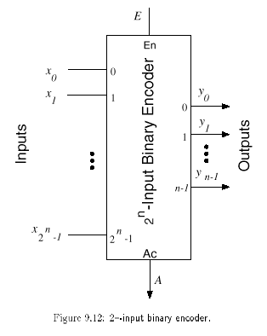
Encoders 编码器
An encoder is a digital circuit that performs the inverse operation of a decoder. An encoder has 2^{n} input lines and n output lines.
The output lines generate the binary equivalent of the input line whose value is 1.

Slide 3
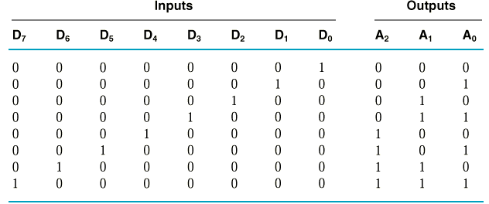
Encoders
E.g. 8-to-3 binary encoder (octal-to-binary)
A₀=D₁+D₃+D₅+D₇
A₁=D₂+D₃+D₆+D₇
A₂=D₄+D₅+D₆+D₇

Slide 4
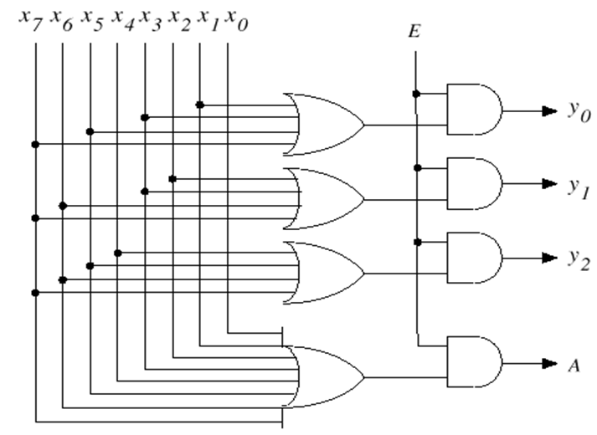
Encoders
One signal at a time.

Slide 5
Priority Encoders 优先编码器
Multiple asserted inputs are allowed; one has priority over all others.
E.g. 4-to-2 Priority Encoder Truth Table
Inputs |  |  |  | Outputs
D₃ | D₂ | D₁ | D₀ | A₁ | A₀ | V
0 | 0 | 0 | 0 | X | X | 0
0 | 0 | 0 | 1 | 0 | 0 | 1
0 | 0 | 1 | X | 0 | 1 | 1
0 | 1 | X | X | 1 | 0 | 1
1 | X | X | X | 1 | 1 | 1

Slide 6
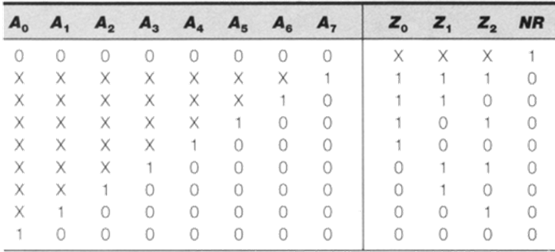
8-to-3 Priority Encoder

Slide 7
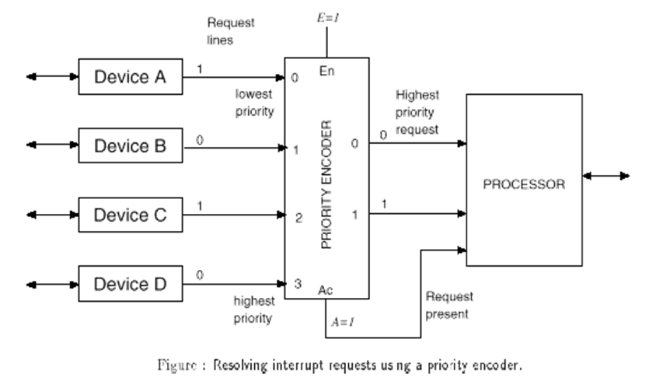
Priority EncoderS

Slide 8
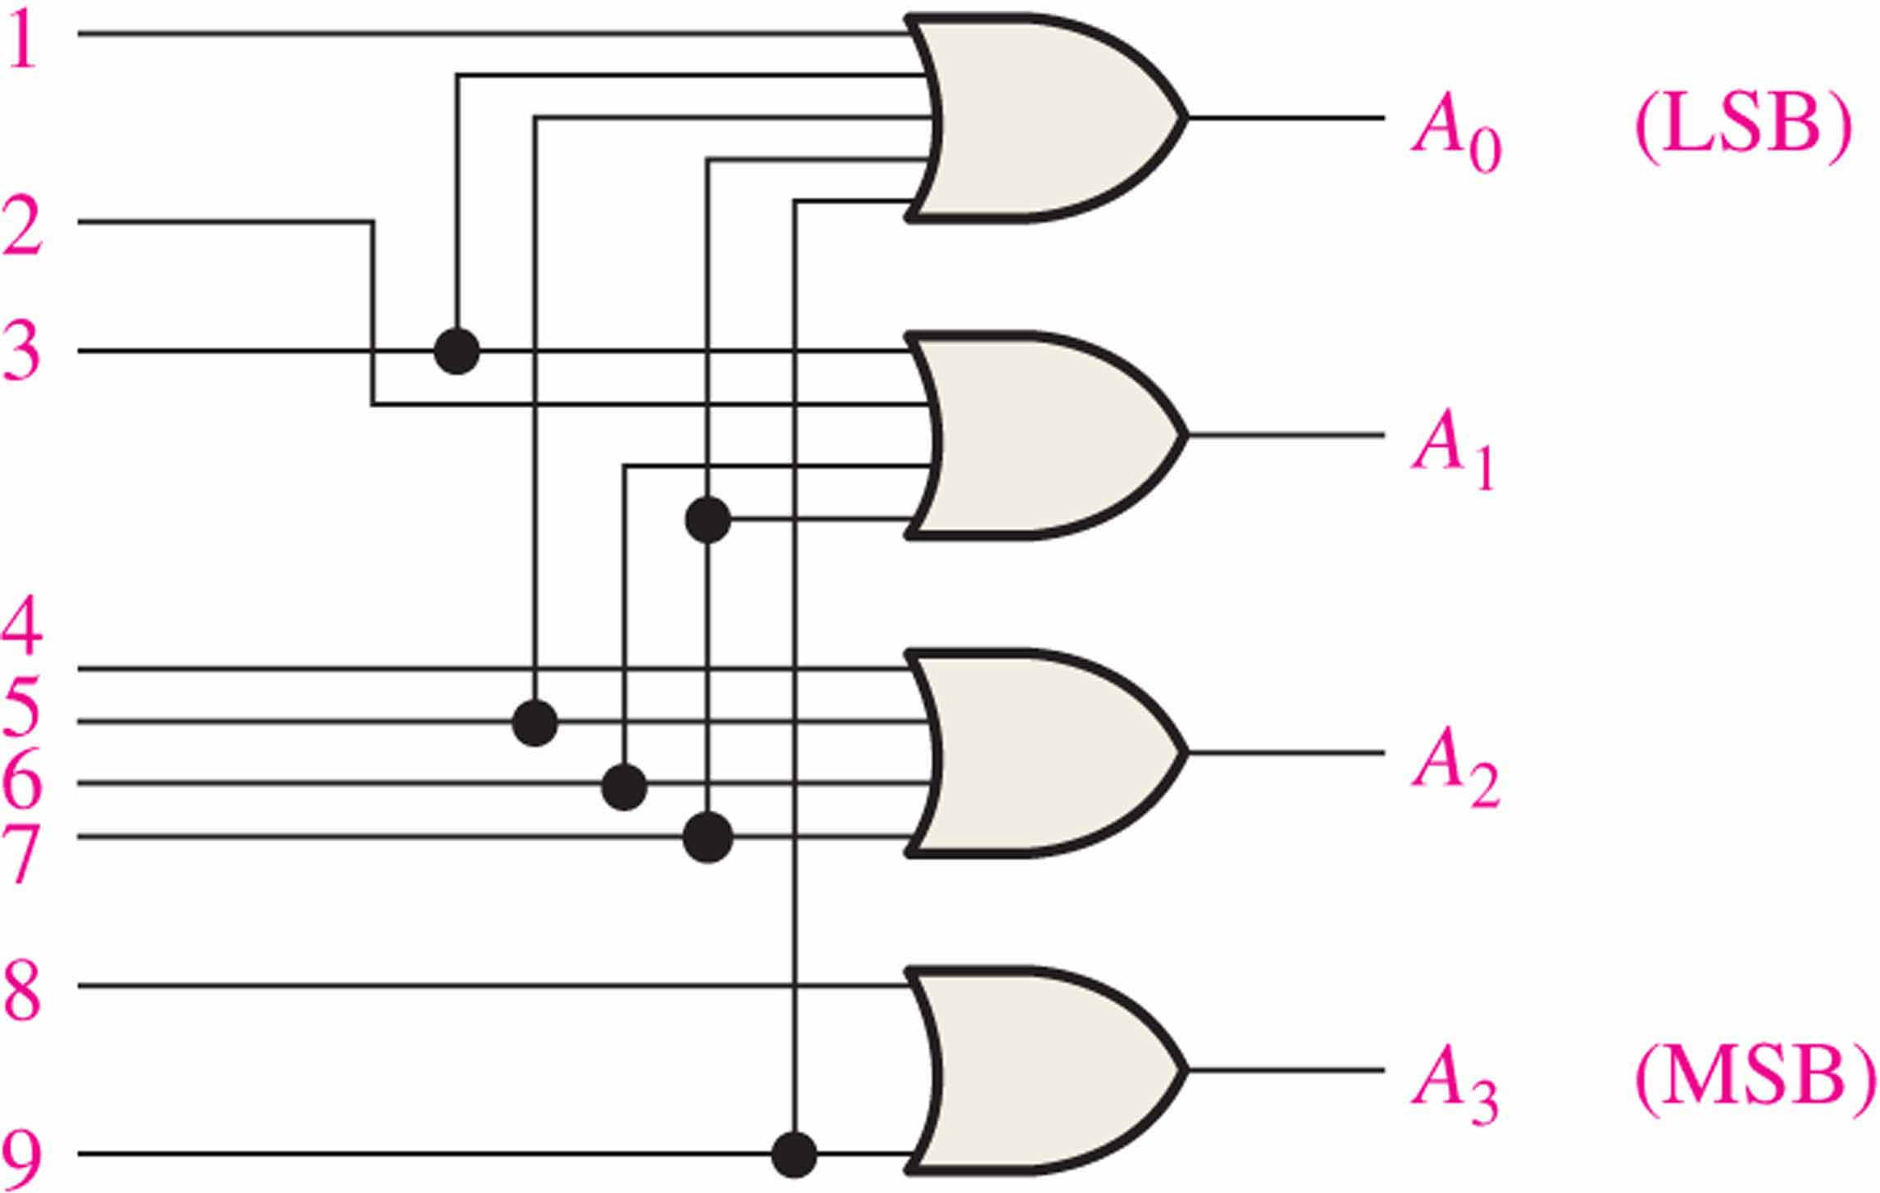
Encoders
The decimal to BCD is an encoder with an input for each of the ten decimal digits and four outputs that represent the BCD code for the active digit.
There is no zero input because the outputs are all LOW when the input is zero.
E.g. Show how the decimal-to-BCD encoder converts the decimal number 3 into a BCD 0011
1
1
1
0
0

Slide 9
Encoders
V_{CC}
The 74HC147 is an example of an IC encoder. It is has ten active-LOW inputs and converts the active input to an active-LOW BCD output.
HPRI/BCD
Decimal input
BCD output
This device is offers additional flexibility in that it is a priority encoder(优先编码器). This means that if more than one input is active, the one with the highest order decimal digit will be active.
74HC147
GND

Slide 10
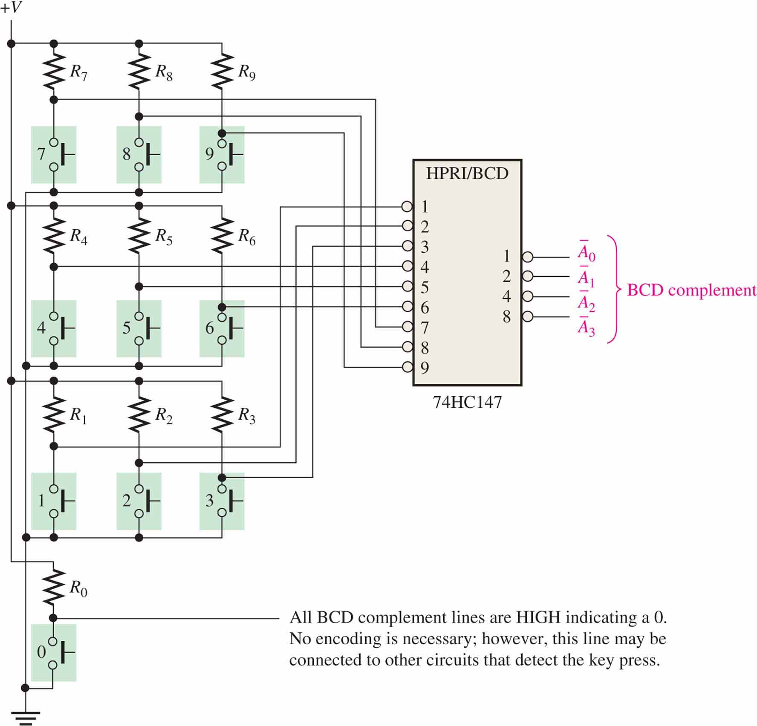
Encoders
Keyboard encoder

Slide 11
Code converters 代码转换器
There are various code converters that change one code to another. Two examples are the four bit binary-to-Gray converter and the Gray-to-binary converter.
E.g. Show the conversion of binary 0111 to Gray and back.
0
1
LSB
1
0
LSB
0
1
1
0
1
1
1
1
0
0
0
MSB
0
MSB
Binary-to-Gray Gray-to-Binary

Slide 12
Multiplexers 数字多路器
“Selects” binary information from one of many input lines and directs it to a single output line. Also know as the “selector” circuit.
Selection is controlled by a particular set of inputs lines whose output depends on the combination of the data input lines.
For a 2^{n}-to-1 multiplexer, there are 2^{n} data input lines and n selection lines whose bit combination determines which input is selected

Slide 13
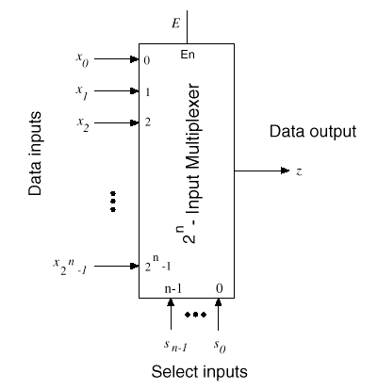
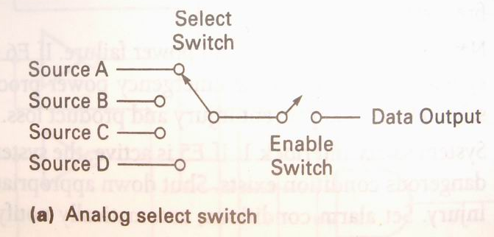
Multiplexers

Slide 14
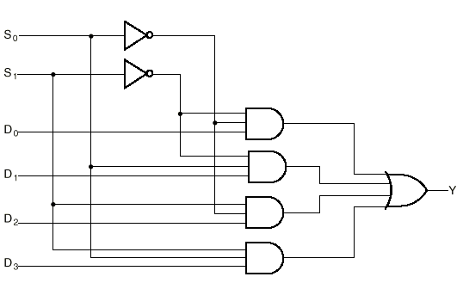
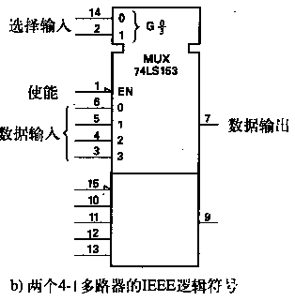
4-1 Multiplexer 4-1多路器
S₁ | S₀ | Y
0 | 0 | D₀
0 | 1 | D₁
1 | 0 | D₂
1 | 1 | D₃
Y = S₁’S₀’D₀ + S₁’S₀D₁ + S₁S₀’D₂ + S₁S₀D₃=∑m_{i}D_{i}

Slide 15
4-1 Multiplexer
Two select lines are shown here to choose any of the four data inputs.
S₀
0
Data
select
1
Question
Which data line is selected if S₁S₀ = 10?
S₁
D₀
Data
output
Data
inputs
D₁
D₂
D₂
D₃

Slide 16
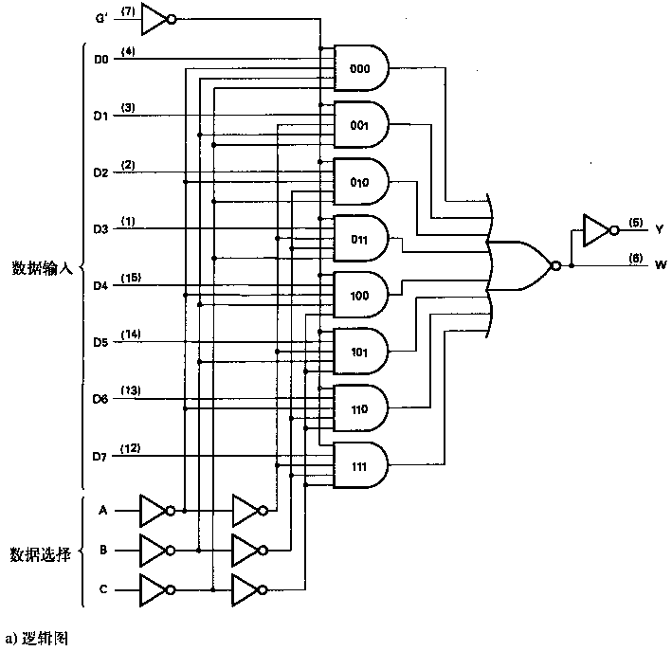
8-to-1 MUX
If G’=1 then Y=0, W=1
Y = C’B’A’D₀ + C’B’AD₁
+ C’BA’D₂ + C’BAD₃
+ CB’A’D₄ + CB’AD₅
+ CBA’D₆ + CBAD₇
=∑m_{i}D_{i}

Slide 17
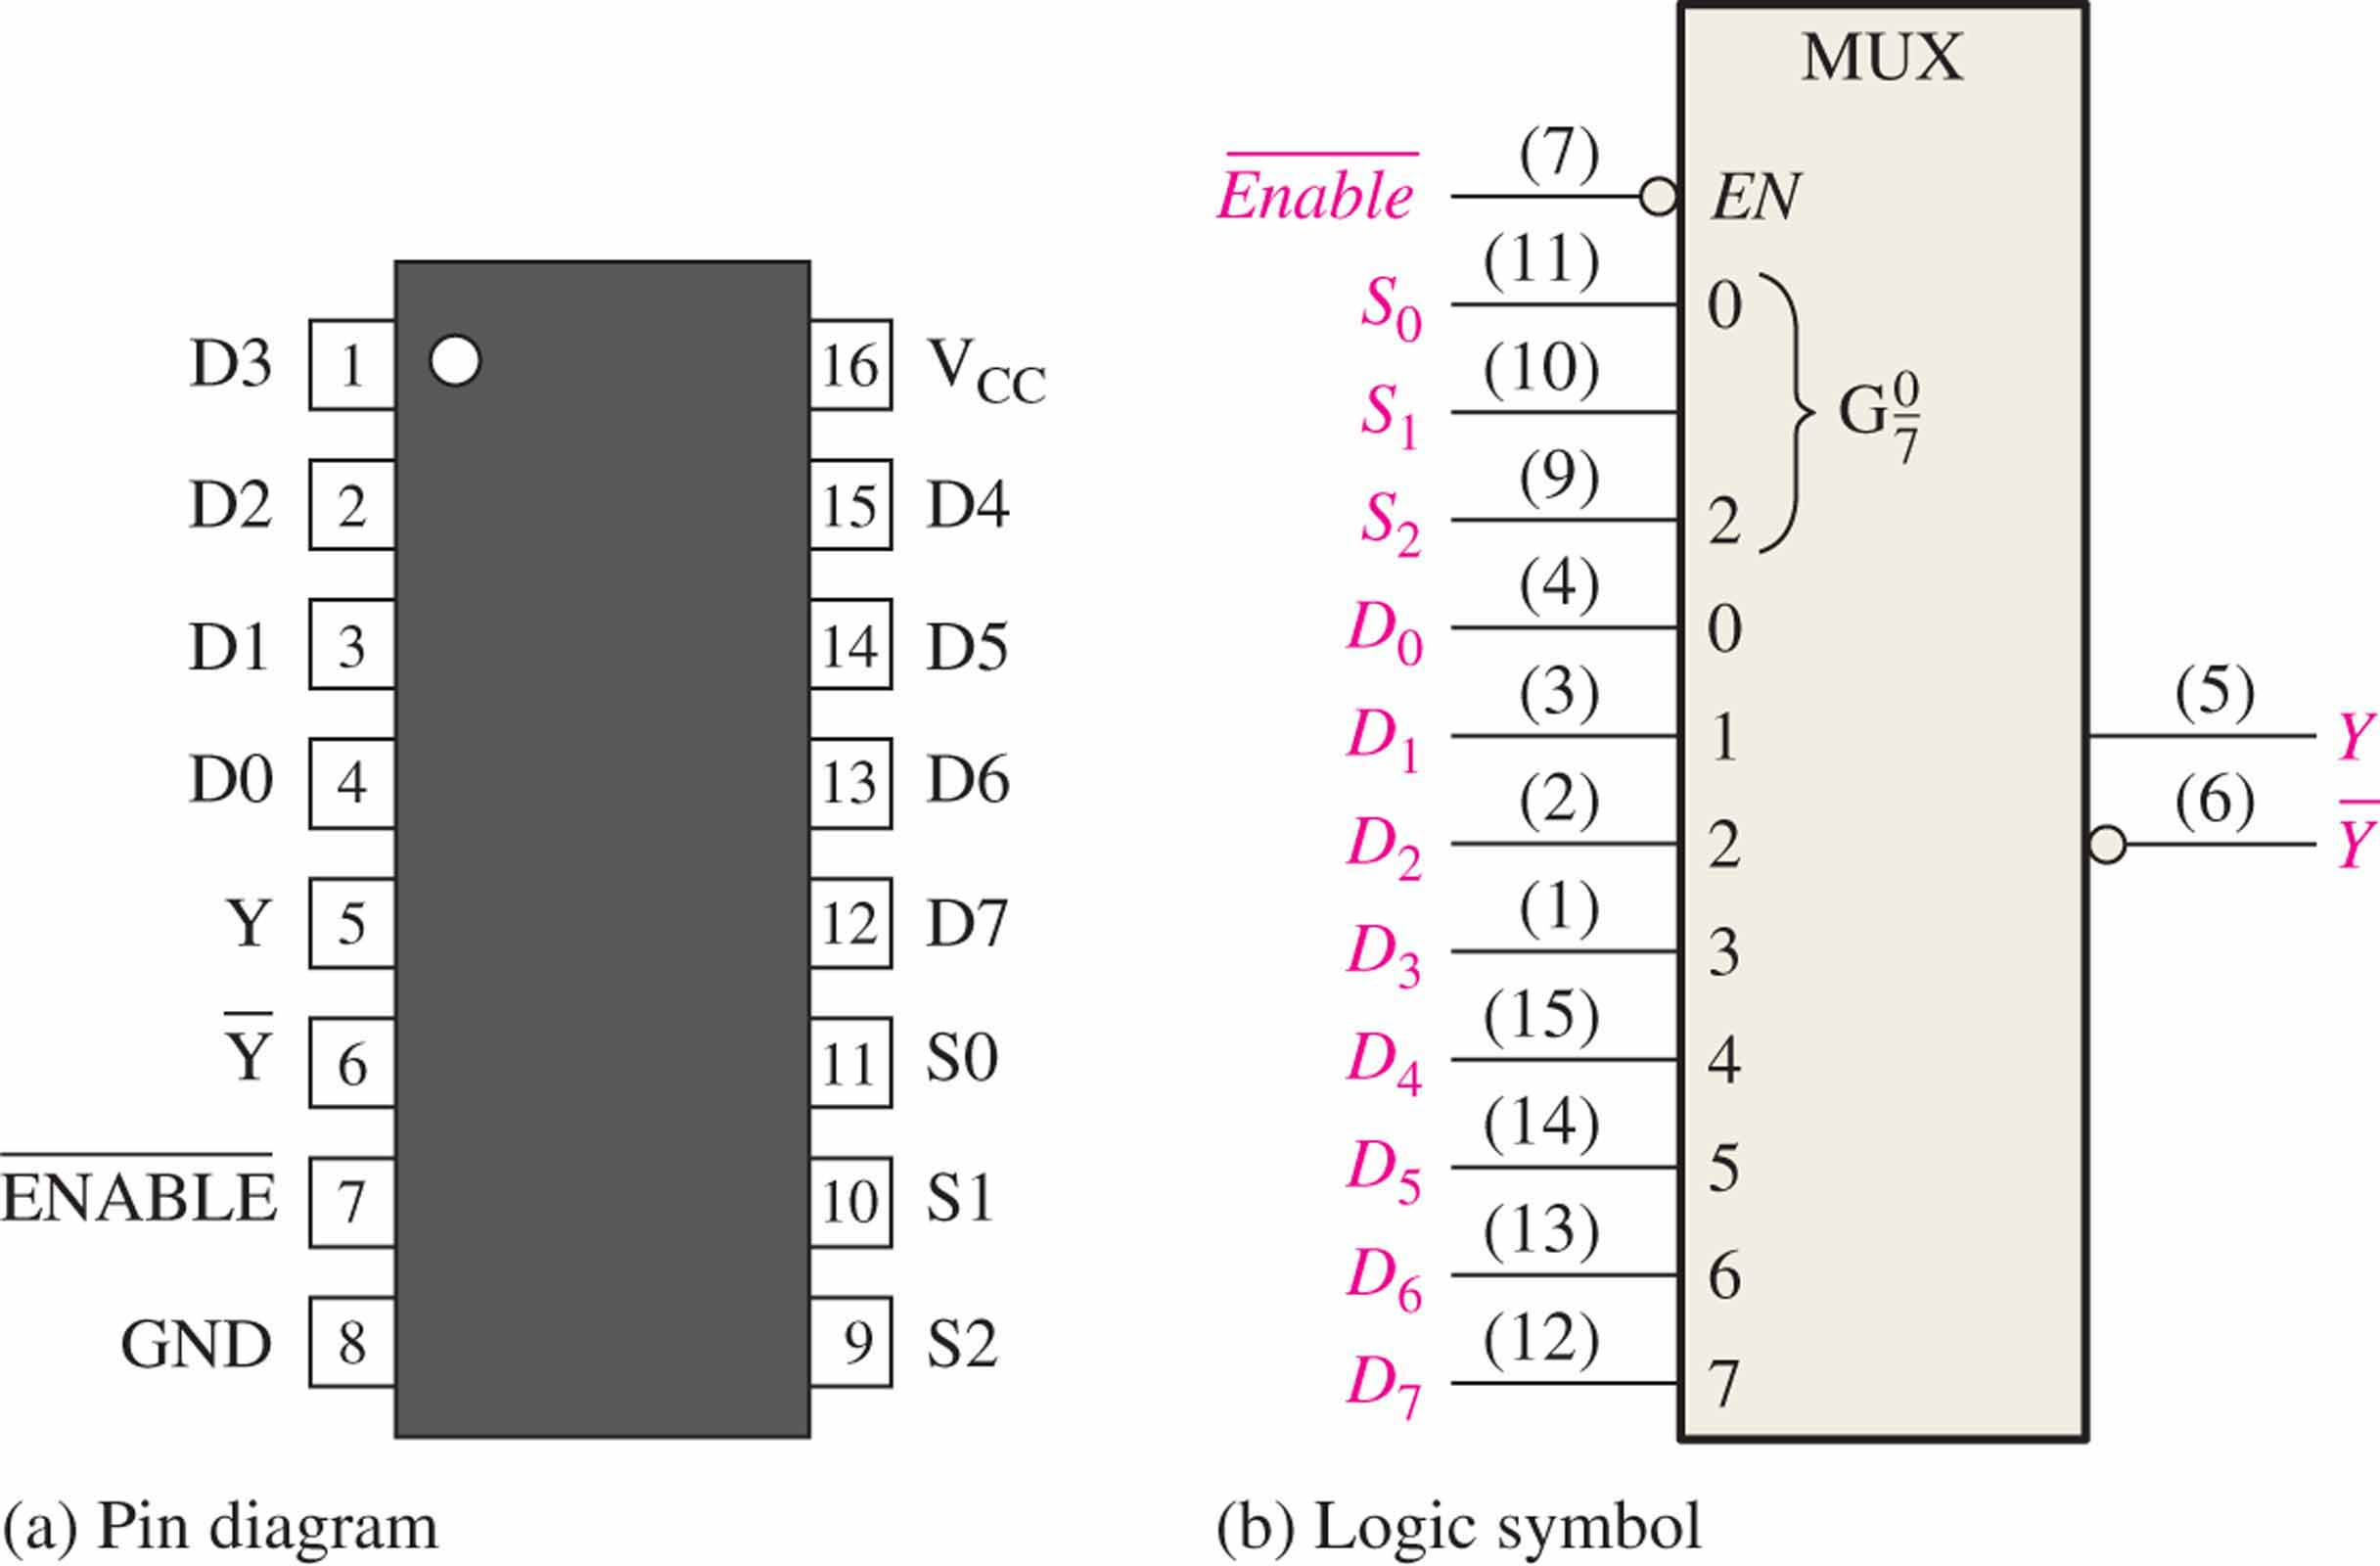
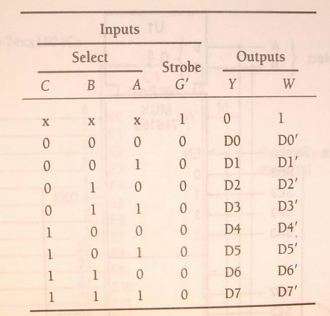
8-to-1 MUX

Slide 18
Multiplexer Expansions 多路器扩展
Until now, we have examined single-bit data selected by a MUX. What if we want to select m-bit data/words?
Combine MUX blocks in parallel with common select and enable signals
Example: Construct a logic circuit that selects between 2 sets of 4-bit inputs (see next slide for solution).

Slide 19
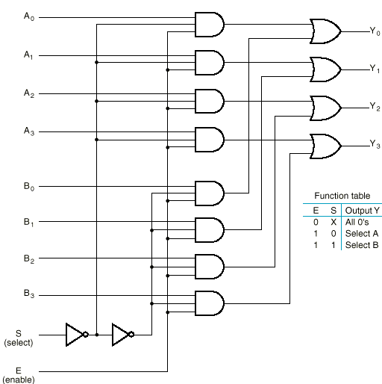
Example: Quad 2-to-1 MUX
Uses four 2-to-1 MUXs with common select (S) and enable (E).
Select line chooses between A_{i}’s and B_{i}’s. The selected four-wire digital signal is sent to the Y_{i}’s
Enable line turns MUX on and off (E=1 is on).

Slide 20
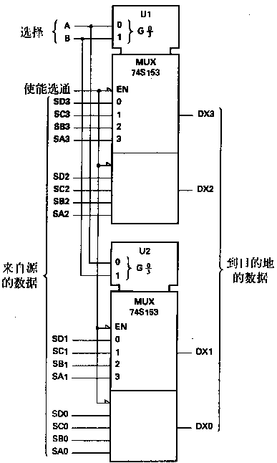
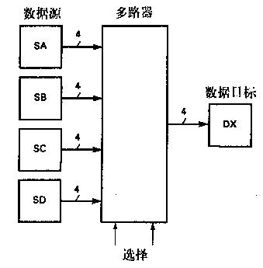
Example: Quad 4-to-1 MUX

Slide 21
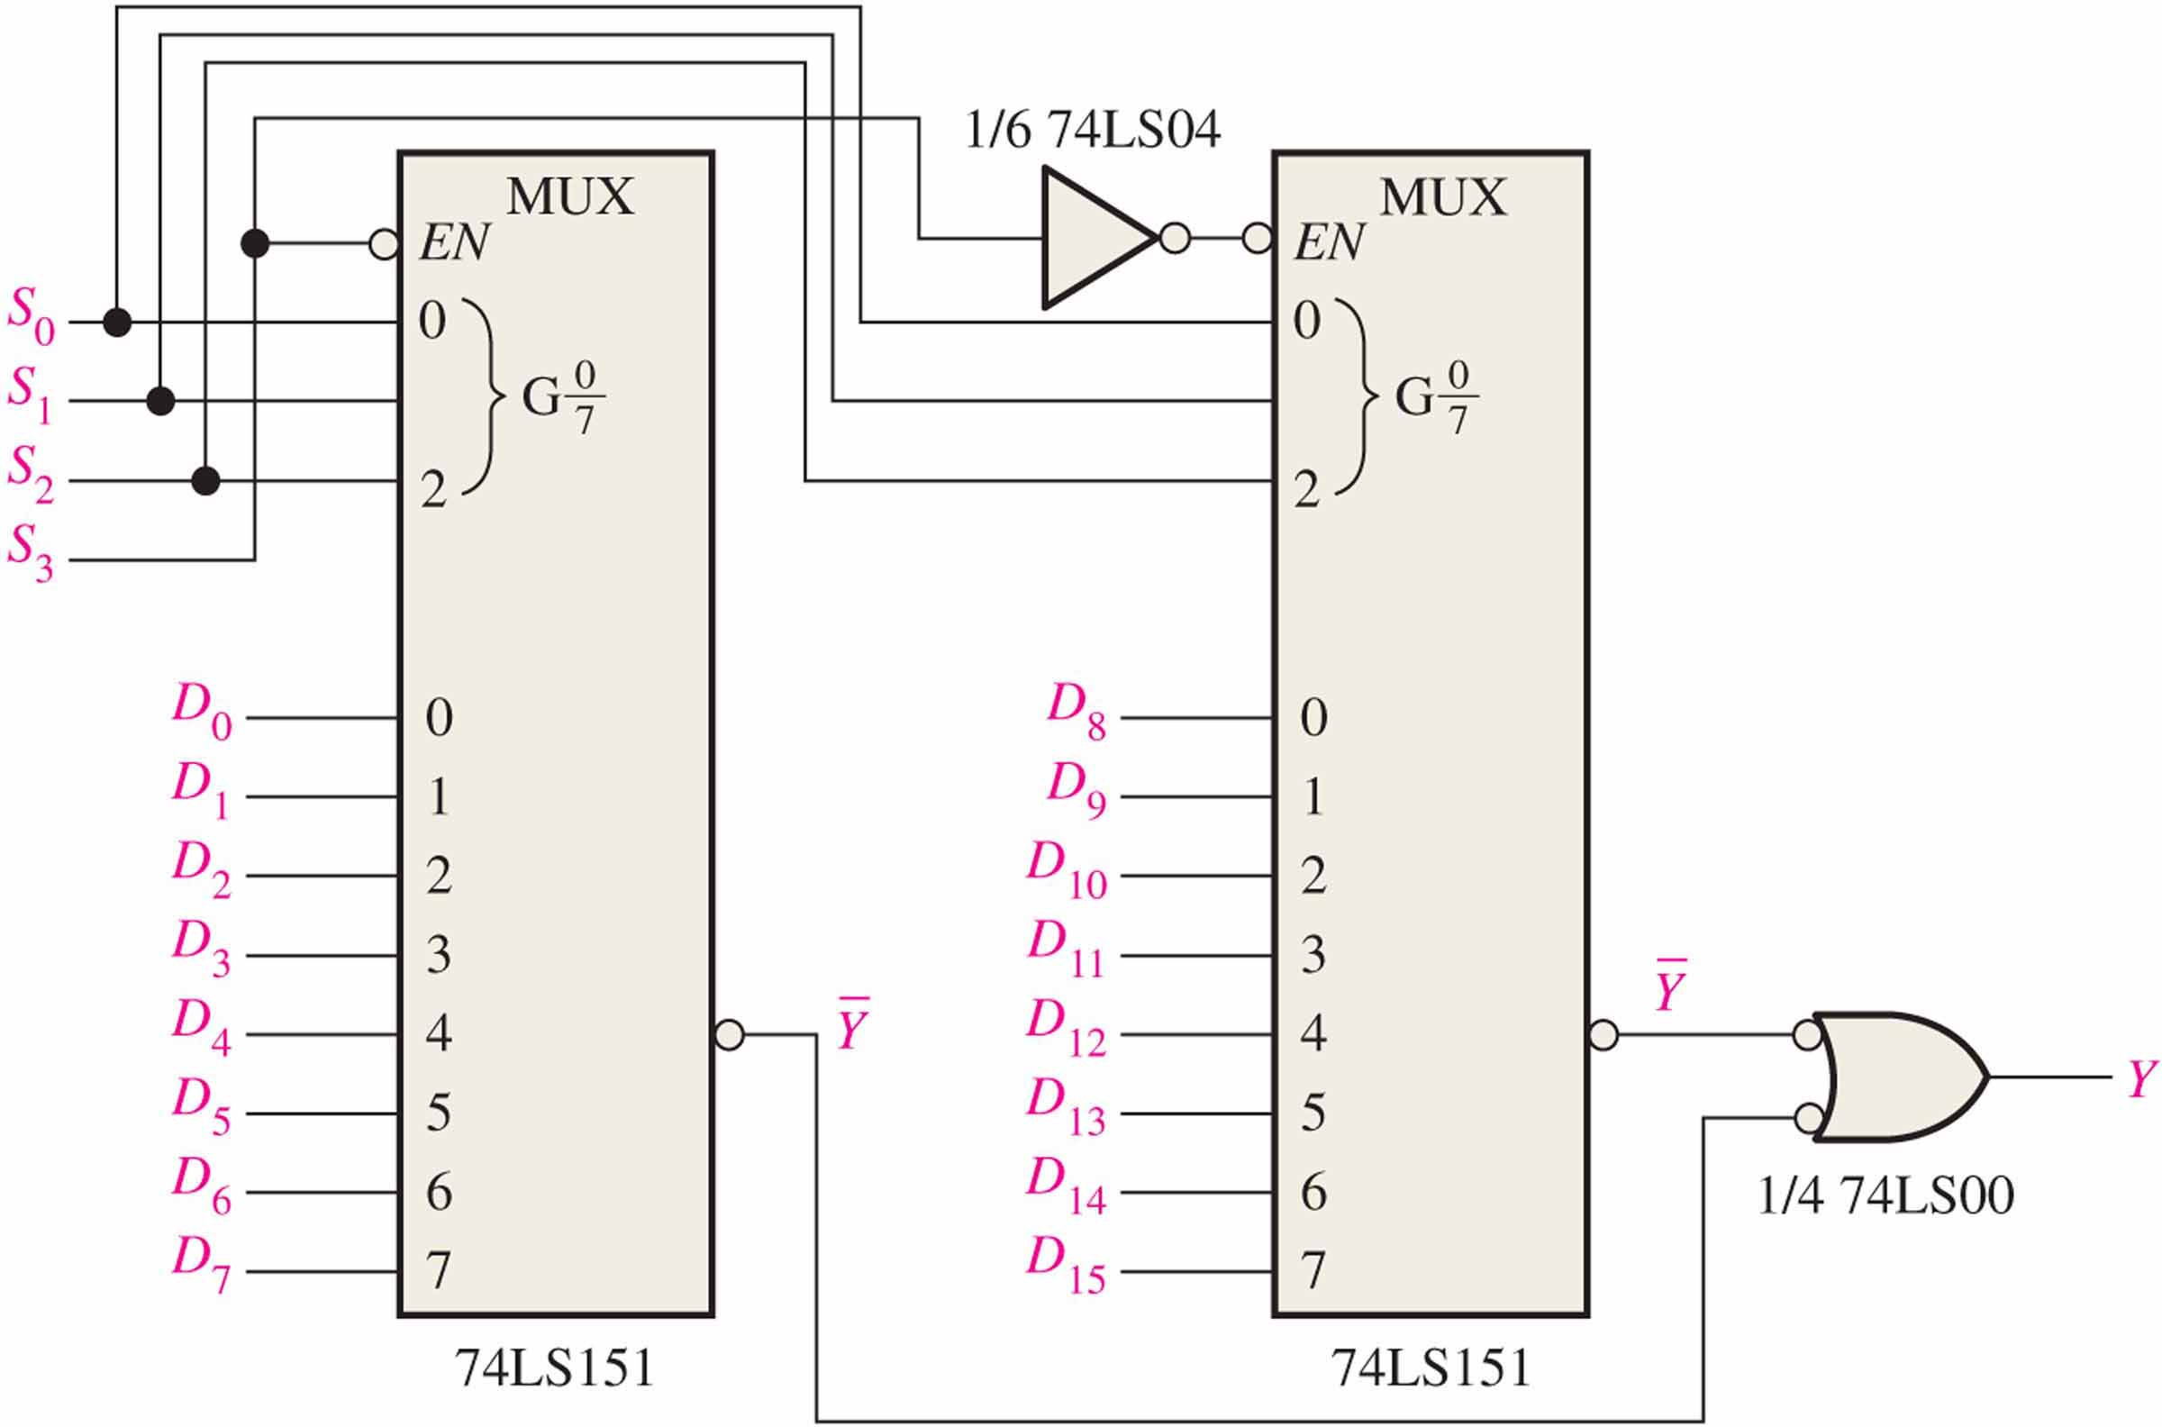
Multiplexer Expansions
A 16-1 multiplexer using two 74LS151

Slide 22
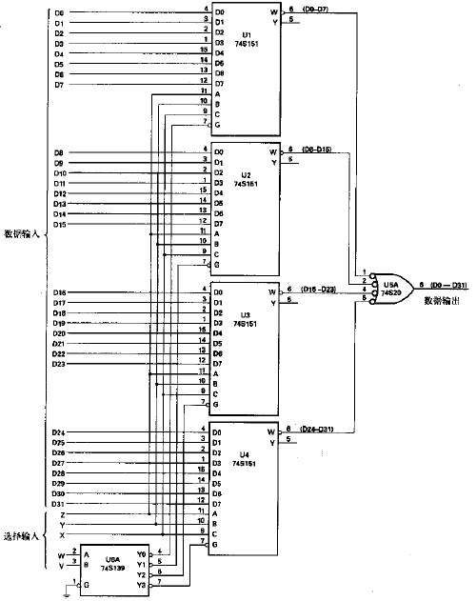
Multiplexer Expansions
A 32-to-1 multiplexer using four 8-to-1 multiplexers and a 2-to-4 decoder

Slide 23
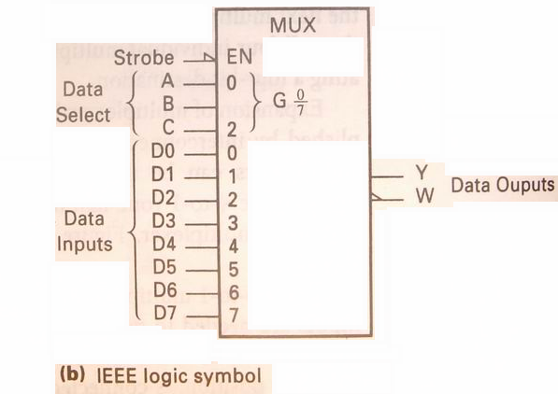
Implementing Boolean functions with Multiplexers
E.g. Using an 8-to-1 multiplexer to realize the Boolean function F=f(x,y,z)=∑(1,2,4,5,7)
Y=C’B’A’D₀ + C’B’AD₁ + C’BA’D₂ + C’BAD₃ + CB’A’D₄ + CB’AD₅ + CBA’D₆ + CBAD₇
F=f(x,y,z) = ∑(1,2,4,5,7) =x’y’z+x’yz’+xy’z’+xy’z+xyz
C=x,B=y,A=z
D₀=D₃=D₆=0 D₁= D₂= D₄= D₅= D₇=1

Slide 24
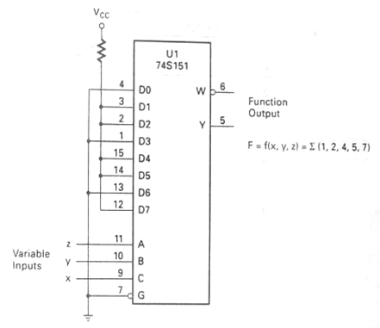
Implementing Boolean functions with Multiplexers
C=x,B=y,A=z D₀=D₃=D₆=0 D₁= D₂= D₄= D₅= D₇=1

Slide 25
Implementing Boolean functions with Multiplexers
Using an 4-to-1 multiplexer to realize the Boolean function F=f(x,y,z)=∑(1,2,4,5,7)
F = f(x,y,z) = ∑(1,2,4,5,7) =x’y’z+x’yz’+xy’z’+xy’z+xyz
Let B=x, A=y
F
z
z’
D₀=z, D₁=z’
D₂=1, D₃=z
1
00
01
11
10
z
xy
z
0
1
1
F = x’y’D₀+x’yD₁+xy’D₂+xyD₃
x
y
1
1
1
1

Slide 26
Implementing Boolean functions with Multiplexers
Y = S₁’S₀’D₀ + S₁’S₀D₁ + S₁S₀’D₂ + S₁S₀D₃=∑m_{i}D_{i}
x | Y | Z | F
0 | 0 | 0 | 0
0 | 0 | 1 | 1
0 | 1 | 0 | 1
0 | 1 | 1 | 0
1 | 0 | 0 | 1
1 | 0 | 1 | 1
1 | 1 | 0 | 0
1 | 1 | 1 | 1
Using an 4-to-1 multiplexer to realize the Boolean function F=f(x,y,z)=∑(1,2,4,5,7)
F = f(x,y,z) = ∑(1,2,4,5,7) =x’y’z+x’yz’+xy’z’+xy’z+xyz
Let B=x, A=y
D₀=z
F
z
F = x’y’D₀+x’yD₁+xy’D₂+xyD₃
z’
1
D₀=z, D₁=z’
D₂=1, D₃=z
z
x
y

Slide 27
Implementing Boolean functions with Multiplexers
Using an 4-to-1 multiplexer to realize the Boolean function F=f(x,y,z)=∑(1,2,4,5,7)
F = f(x,y,z) = ∑(1,2,4,5,7) =x’y’z+x’yz’+xy’z’+xy’z+xyz
Let B=x, A=y
F
z
z’
1
z
F = x’y’D₀+x’yD₁+xy’D₂+xyD₃
x
y
D₀=z, D₁=z’ D₂=1, D₃=z

Slide 28
Implementing Boolean functions with Multiplexers
Using an 4-to-1 multiplexer to realize the Boolean function F=f(x,y,z)=∑(1,2,4,5,7)
F = f(x,y,z) = ∑(1,2,4,5,7) =x’y’z+x’yz’+xy’z’+xy’z+xyz
Let B=x, A=z
F
y
y’
D₀=y, D₁=y’
D₂=y’, D₃=1
y’
00
01
11
10
1
xy
z
0
1
1
F = x’z’D₀+x’zD₁+xz’D₂+xzD₃
x
z
1
1
1
1

Slide 29
Implementing Boolean functions with Multiplexers
Using an 4-to-1 multiplexer to realize the Boolean function F=f(x,y,z)=∑(1,2,4,5,7)
F = f(x,y,z) = ∑(1,2,4,5,7) =x’y’z+x’yz’+xy’z’+xy’z+xyz
Let B=z, A=y
F
x
x’
D₀=x, D₁=x’
D₂=1, D₃=x
1
00
01
11
10
x
xy
z
0
1
1
F = z’y’D₀+z’yD₁+zy’D₂+zyD₃
z
y
1
1
1
1

Slide 30
exercise
Implement function using a 4-to-1 MUX
F(X,Y,Z) = Σm(1,2,6,7)
F(A,B,C) = Σm(1,3,5,6)

Slide 31
exercise
F(X,Y,Z) = Σm(1,2,6,7) = X’Y’Z + X’YZ’ + XYZ’ + XYZ
There are n=3 inputs. The first n-1 (=2) inputs serve as the selection lines
F
z
00
01
11
10
XY
Z
z’
0
1
1
0
1
1
1
1
x
y

Slide 32
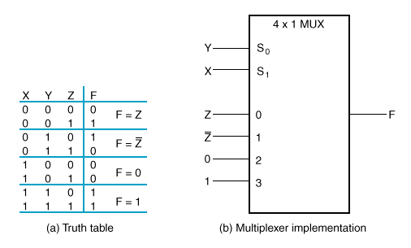
exercise
F(X,Y,Z) = Σm(1,2,6,7) = X’Y’Z + X’YZ’ + XYZ’ + XYZ

Slide 33
exercise
A | B | C |  | F
0 | 0 | 0 |  | 0
0 | 0 | 1 |  | 1
0 | 1 | 0 |  | 0
0 | 1 | 1 |  | 1
1 | 0 | 0 |  | 0
1 | 0 | 1 |  | 1
1 | 1 | 0 |  | 1
1 | 1 | 1 |  | 0
A=B=0
F=C
F(A,B,C) = ∑m(1,3,5,6)
A=0 B=1
F=C
F
C
00
01
11
10
AB
C
C
A=1 B=0
F=C
0
C
1
1
C’
A=B=1
F=C’
1
1
1
A
B

Slide 34
Implementing Boolean functions with Multiplexers
E.g. Consider the following Boolean expression given in sum-of-product form:
F(x₁,x₂,x₃)=x₁’x₂’+x₁x₂’+x₁x₃
Derive a circuit for using only 2-to-1 multiplexers.

Slide 35
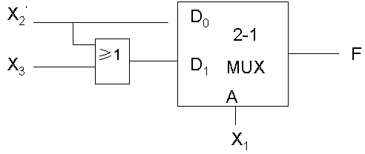
Implementing Boolean functions with Multiplexers
00
01
11
10
x₁x₂
x₃
0
1
1
D₀=X₂’
D1=X₂’+X₃
1
1
1
1

Slide 36
exercise
F(A,B,C,D)=∑m(1,2,4,9,10,11,12,14,15)
Derive a circuit for using 4-to-1 multiplexers.
(Do it yourself)

Slide 37
MUX as a Universal Gate
We can construct OR, AND, and NOT gates using 2-to-1 MUXs. Thus, 2-to-1 MUX is a universal gate.
z = x₀x₁ + x₀’·0
= x₀x₁
z = x₀ + x₀’x₁
= x₁ + x₀
z = x·0 + x’·1
= x’

Slide 38
HOMEWORK
F(A,B,C,D)=∑m(0,3,4,5,7,9,13,15)
Derive a circuit for using 8-to-1 multiplexers.

Slide 39
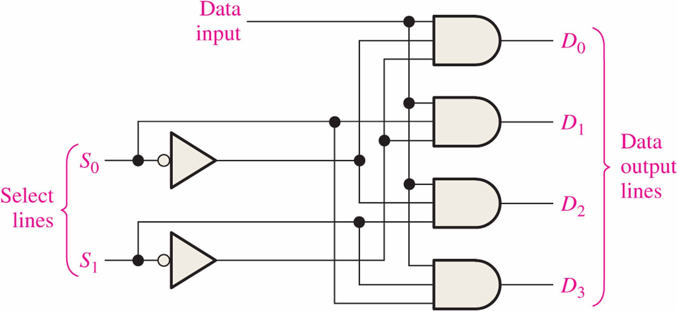
Demultiplexers 多路分配器
A demultiplexer (DEMUX) performs the opposite function from a MUX. It switches data from one input line to two or more data lines depending on the select inputs.

Slide 40
Demultiplexers
The 74LS138（3-8译码器） was introduced previously as a decoder but can also serve as a DEMUX.
When connected as a DEMUX, data is applied to one of the enable inputs, and routed to the selected output line depending on the select variables.
Data select lines
Data outputs
Enable
inputs
74LS138

Slide 41
Parity Generators/Checkers 奇偶发生器/校验器
Parity is an error detection method that uses an extra bit appended to a group of bits to force them to be either odd or even. In even parity, the total number of ones is even; in odd parity the total number of ones is odd.
E.g. The ASCII letter S is 1010011. Show the parity bit for the letter S with odd and even parity.
odd parity: 11010011
even parity: 01010011

Slide 42
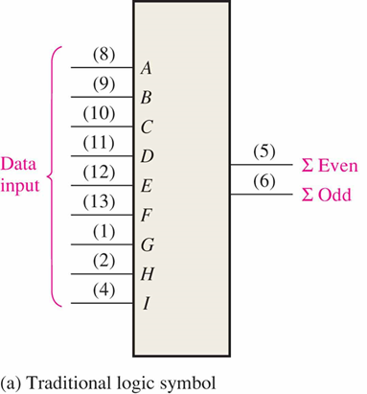
Parity Generators/Checkers
The 74LS280 can be used to generate a parity bit or to check an incoming data stream for even or odd parity.
Checker: The 74LS280 can test codes with up to 9 bits. The even output will normally be HIGH if the data lines have even parity; otherwise it will be LOW. Likewise, the odd output will normally be HIGH if the data lines have odd parity; otherwise it will be LOW.

Slide 43
Parity Generators/Checkers
Generator:
To generate even parity, the parity bit is taken from the odd parity output.
To generate odd parity, the output is taken from the even parity output.

